Slide 1

-:Presentation for Insight:-
-Soumanti Chatterjee

Slide 2

Introduction of Insight:-
Insight Enterprises, Inc., founded in 1988 by Eric and Tim Crown, is a global technology company based in Tempe, Arizona. As a Fortune 500 solutions integrator, Insight accelerates digital transformation for businesses worldwide by leveraging technical expertise, a broad solutions portfolio, and supply chain capabilities. Operating in the EMEA region, APAC region, United Kingdom, United States, and Canada, Insight drives speed, scale, resilience, and innovation, helping clients achieve their ambitious goals. Insight has expanded its IT services, cloud solutions, and advanced communications capabilities globally. With 16,520 employees, Insight generated $9.17 billion in revenue in 2023, a decrease from $10.43 billion in 2022.

Slide 3

Acquisitions:-
BlueMetal
Ignia
Datalink
PCM
Amdaris
Eden Prairie
Calence LLC
Caase.com
Minx Ltd
Action Computer Supplies Holdings
Specializing in innovative solutions on the Microsoft platform, strengthening Insight’s position in digital transformation services.
An Australian-based business technology consulting firm that bolstered Insight’s capabilities in the APAC region.
A provider of data center services and solutions, enabling Insight to offer comprehensive IT infrastructure optimization services.
A key acquisition that expanded Insight's operations in the U.S., Canada, and the U.K., enhancing its IT product and service offerings.
Known for software development and digital transformation, Amdaris added depth to Insight’s custom software solutions.
Focused on data center services, this acquisition enhanced Insight's expertise in managing complex IT environments.
A technology firm specializing in Cisco networking and advanced communications, expanding Insight’s networking and communications solutions.
A Dutch cloud service provider, which strengthened Insight’s cloud capabilities in Europe.
A U.K.-based network integrator with Cisco Gold Partner accreditation, which broadened Insight’s European operations.
A U.K.-based direct marketer, expanding Insight’s market reach in the U.K.

Slide 4








Areas of expertise:-
Cloud
Build a private, public, hybrid or multicloud ecosystem that accelerates innovation using a performance- and cost-driven framework.
Cybersecurity
Develop a comprehensive security strategy that protects your network, end users and data to reduce organizational risk.
Data and AI
Leverage generative AI, data modeling, business analysis and more to navigate hurdles and improve productivity.
Devices
Redefine your devices and reimagine work with AI-enabled end-user devices that improve productivity and simplify management.
Digital workplace
Give your employees modern work experiences with top-tier support, tools that fuel productivity and end-to-end IT asset management.
Intelligent edge
Collect, analyze and act on data across your entire organization to support real-time decision-making.
Modern apps
Develop new tools to drive business value, transform legacy applications and create a culture that embraces Agile approaches.
Modern infrastructure
Architect, modernize and manage your entire IT infrastructure to support business transformation goals.

Slide 5
Services:-
Consulting services
Data center transformation
Cloud and workload alignment
Security and disaster recovery
IT optimization
Automation and orchestration
Managed IT services
Managed storage, backup and recovery
Managed cloud, network and compute
Managed security
Managed support
InsightCloud® Care
IT infrastructure services
Data center Services
Network Services
Deployments Services
IT Outsourcing

Slide 6
Industries:-
Construction
Esports
Financial services
Healthcare & life sciences
Manufacturing
Retail & restaurant
Service providers
Travel & tourism
Federal Government
State and local Government
Higher Education

Slide 7
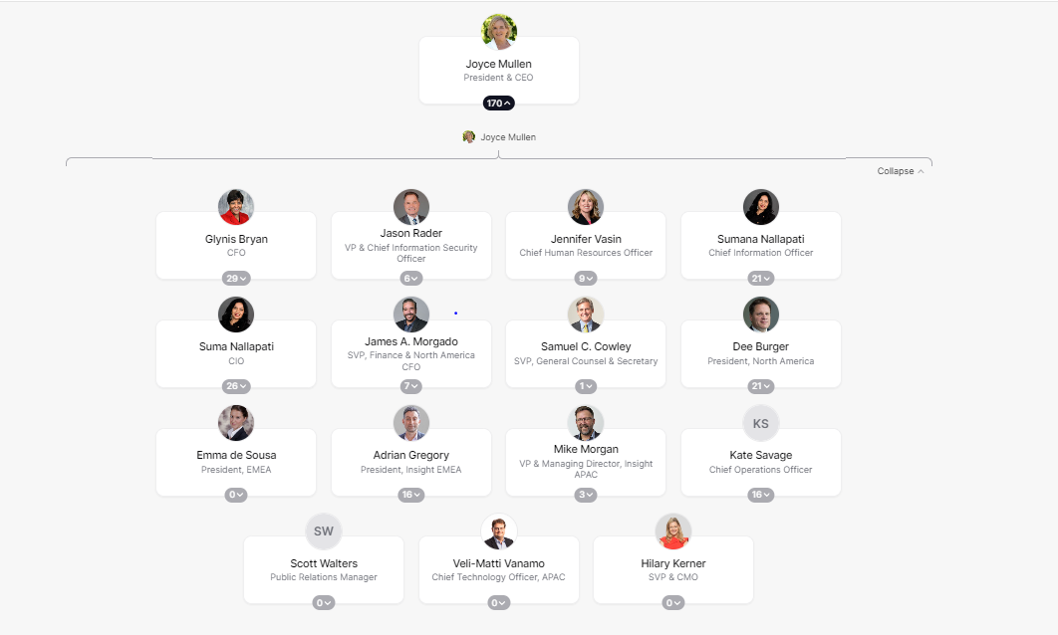
Organizational Structure:-

Slide 8

Platforms & Technology Used:-
Microsoft Azure
Memcached
VeloCloud
Cisco Networking
VMware vCenter Lab Manager
Google Cloud
Brocade Switches
Cisco AppDynamics
HCL Domino
MikroTik
Silver Peak
Akamai DNS
Fortinet
HPE Servers
IBM AIX
Solaris
F5 BIG-IP Platform
SAP HANA
IBM Mainframe
SolarWinds
AWS
Brocade
Viptela
Citrix ADC
Extreme Networks
Cambium
Barracuda Networks
Microsoft Hyper-V
Dell EMC Disaster Recovery
Microsoft Exchange Online
Cisco FlexPod
Microsoft Windows
Salesforce Lightning Web Components
And many more

Slide 9
Decision Makers Details:-
Decision Makers Name | Designation | Key Focus Area | Total Years of Experience | Email Id | Mobile No. | LinkedIn URL
Barnaby Jeans | Director - Microsoft Cloud | Cloud | 29+ | barnaby.jeans@insight.com | +1 425-435-6487 | https://www.linkedin.com/in/barnabyjeans/
Juan Orlandini | CTO, North America | Networking,Engineering | 37+ | juan.orlandini@insight.com | +1 770-617-5506 | https://www.linkedin.com/in/jorlandini/
Jitesh Midha | Director of Information Technology | Data, Networking, Cloud | 28+ | jitesh.midha@insight.com | +91 98860 90444 | https://www.linkedin.com/in/jiteshmidha/
Joy Levine-Winn | Vice President, Cloud Solutions | Cloud | 28+ | joy.levine-winn@insight.com | +1 480-366-7141 | https://www.linkedin.com/in/joylevinewinn/
Mathew Skaff | Vice President, Global Information Technology | Data,Cloud,Security | 26+ | mathew.skaff@insight.com | +1 602-628-0045 | https://www.linkedin.com/in/mathewskaff/
Rob Green | Chief Digital Officer | Digital Transformation,AI/ML,Cloud | 26+ | rob.green@insight.com | +1 206-601-1831 | https://www.linkedin.com/in/rob-green-7b291/
Phil Hawkshaw | EMEA Director of Technology & CTO | Data,AI | 30+ | phil.hawkshaw@insight.com |  | https://www.linkedin.com/in/thomascane/
Michael Griffin | Chief Data Scientist | Data | 30+ | michael.griffin@insight.com | +1 617-448-5090 | https://www.linkedin.com/in/michael-griffin-phd-91999879/

Slide 10

Latest News:-
New Insight Service Accelerates Data Analytics Adoption with Microsoft Fabric
May 21, 2024
Insight Works with Microsoft, Qualcomm as Early Provider of Next-Generation AI PCs
May 1, 2024
Insight Acquires Infocenter, 2024 ServiceNow Partner of the Year
April 18, 2024
Insight Survey: Employees Embrace AI in the Workplace, Want More Training, Guidance From Employers
April 17, 2024
Insight Security Service Recognized with Microsoft Verified Managed XDR Solution Status
April 11, 2024
Insight 2024 Corporate Citizenship Report Reflects Focus on Using Tech for Good
March 19, 2024
Insight Named NVIDIA’s 2024 Americas Software Partner of the Year
March 4, 2024
Insight Recognized as One of Barron’s 100 Most Sustainable Companies for 2024
January 29, 2024
Insight Signs New Microsoft Global Strategic Partnership Framework Agreement to Accelerate Cloud Growth

Slide 11

Technical Job Openings:-
Sr Cloud Solution Specialist
Gurugram, India
COGS
SQL Server Database Administrator
Gurugram, India
Information Technology
Senior Network Analyst (contract)
Edmonton, Alberta, Canada
COGS
Hybrid
Technical Support Escalation Engineer
Gurugram, Haryana, India
Service Ops
AKS Architect
Gurugram, India and 10 more
COGS
Cloud Solution Specialist-Security
Gurugram, India
COGS
Cloud Engineer II
Gurugram, India
COGS
Cloud Solution Specialist
Gurugram, India
COGS
Developer Sr
Gurugram, India
Information Technology
Consultant I
Gurugram, India
Information Technology
Hybrid
Cloud Technical Lead
Gurgaon, India
COGS
Developer II
Gurugram, Haryana, India
Information Technology
Sr Consultant
Gurugram, India
COGS
Sr Consultant
Gurugram, India
COGS
Cloud Engineer II
Gurugram, India
COGS

Slide 12

Why Insight?
Tailored Solutions: Customized strategies to meet your specific business needs.
Industry Expertise: Deep understanding across multiple sectors for effective solutions.
Comprehensive Services: Full support from consultation to implementation and beyond.
Technology Partnerships: Access to cutting-edge tools through leading tech collaborations.
Proven Success: Demonstrated track record in enhancing business performance.
Sustainable Growth: Long-term solutions designed for continuous business evolution.
Customer-Centric: Client-focused approach, ensuring solutions align with your goals.

Slide 13
Insight’s Selling Proposition
Market Need
As businesses undergo digital transformation, they face a multitude of challenges across various areas. The need for scalable and cost-effective cloud solutions is crucial as companies navigate their transition to cloud ecosystems. Robust cybersecurity is essential to protect against the rising tide of sophisticated cyber threats and ensure compliance with regulations. In an era dominated by big data, organizations require effective data management and AI integration to unlock actionable insights and drive innovation. The demand for smart, AI-enabled devices is growing to support remote and hybrid work environments. Modern workplace solutions are needed to provide flexibility, productivity tools, and seamless IT management. Intelligent edge solutions are critical for real-time data processing across industries like manufacturing and healthcare. Businesses also need modern applications to replace outdated systems and foster agility, and updated IT infrastructure to support growth and innovation.
Selling Point
Insight’s expertise across these areas offers tailored solutions to address these pressing challenges. Our cloud solutions ensure seamless integration and optimization of performance and costs, while maintaining robust security. We provide a comprehensive cybersecurity strategy that protects against evolving threats and ensures compliance. Our advanced data and AI solutions empower businesses to harness their data and make informed decisions, driving productivity and growth. Insight’s AI-enabled devices enhance productivity and simplify management in dynamic work environments. Our digital workplace solutions foster employee engagement and productivity with top-tier support and modern tools. We enable real-time data processing with intelligent edge solutions, enhancing operational efficiency and customer experiences. Our modern app solutions transform legacy systems and support Agile innovation, while our modern infrastructure solutions offer a scalable, reliable, and secure foundation for business growth and transformation.

Slide 14
InOpTra’s Unique Selling Proposition (USP):-
Tailored Industry-Specific Solutions: Customized strategies designed for your unique industry needs.
Cutting-Edge
Technology Partnerships: Leveraging the latest tools through top tech collaborations.

Slide 15

Let’s Discuss
Thank You!

